Slide 1



Renting System
Supervisor : Dr. Mohamed Elsharkawey Date: 07-07-2024

Slide 2
Presentation Agenda
Project Team
Introduction
Problem Statement
Objectives
Project Scope
Technical Overview
Use Case and ERD Diagram
User Experience & UI Design
Tools
Backend Development
Mobile Development
Frontend Development
Challenges & Solutions
Future Work
Testing & Quality Assurance
Deployment
Lessons Learned
Project Demo
Acknowledgements

Slide 3
Project Team
Mohamed Saeed Ragab (Backend Developer)
Hassan Mostafa Gamil (Frontend Developer)
Aisha Mohamed Fathy (UX/UI Designer)
Esraa Ahmed Abd Elsalam (Frontend Developer)
Ahmed Tamer Ahmed (Mobile Developer)
Youssef Ali Faied (Mobile Developer)

Slide 4
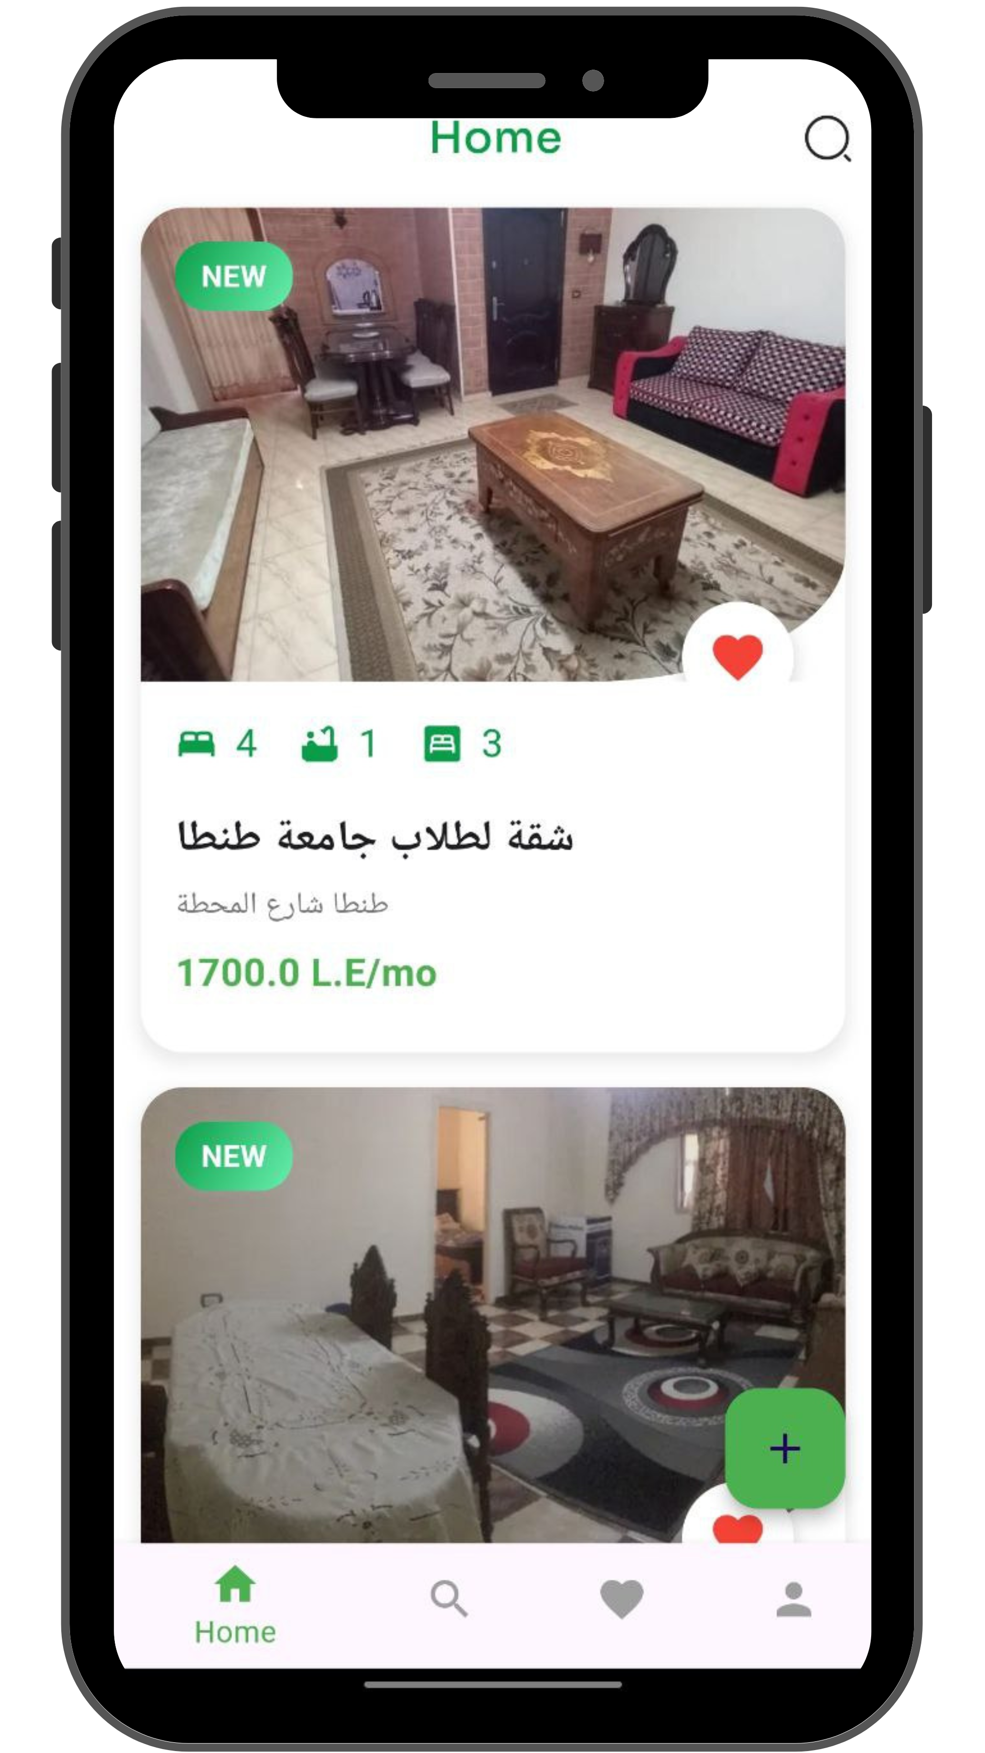
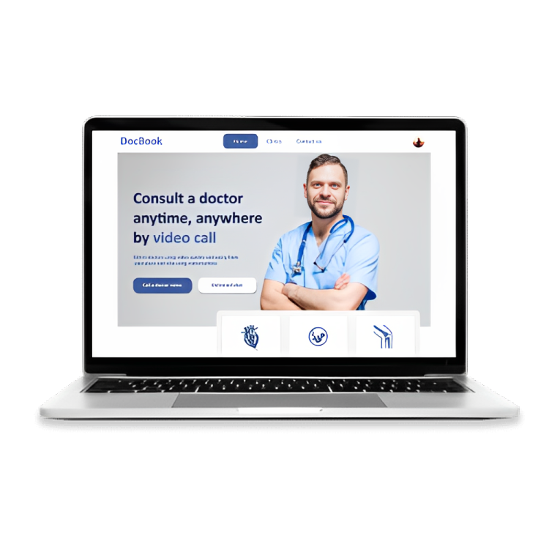
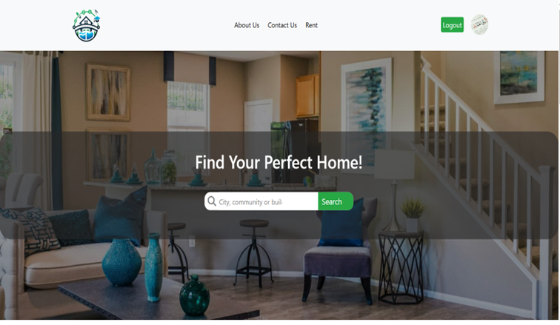
Project Introduction
Brief Overview of the Renting System Project:
The Renting System is a comprehensive platform designed to simplify and streamline the rental process for property owners and tenants. The system offers features such as property listings, search functionality, booking management, and user profiles.

Slide 5
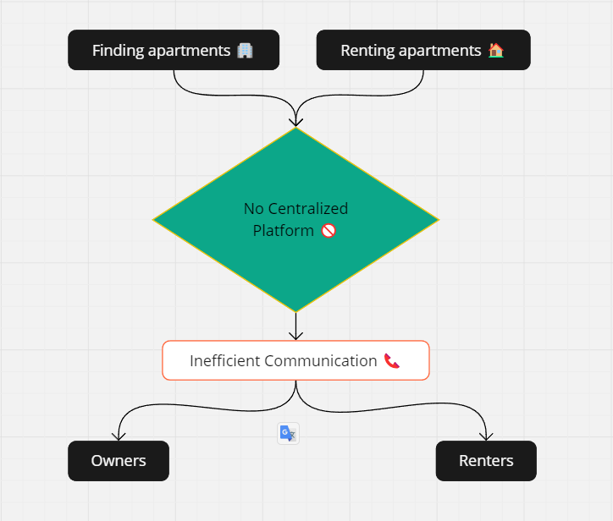
Problem Statement
The Problem:
Finding and renting apartments can be a time-consuming and complicated process.
Lack of a centralized platform where users can view and manage all rental listings.
Communication between owners and renters is often inefficient.
Our Solution:
A centralized platform that connects renters and owners.
Efficient search and booking functionalities.
Streamlined communication and management of rental properties.

Slide 6
Objectives
Key Objectives:
Create a user-friendly platform for renting apartments.
Implement efficient search and filter functionalities.
Enable seamless communication between renters and owners.
Ensure secure and reliable transactions.

Slide 7
Project Scope
Included:
User registration and authentication.
Apartment listing and search functionalities.
Users can add apartments to favourite.
Admin dashboard for managing listings and users.
Excluded:
Property management features beyond rental listings.
Advanced analytics and reporting tools.

Slide 8
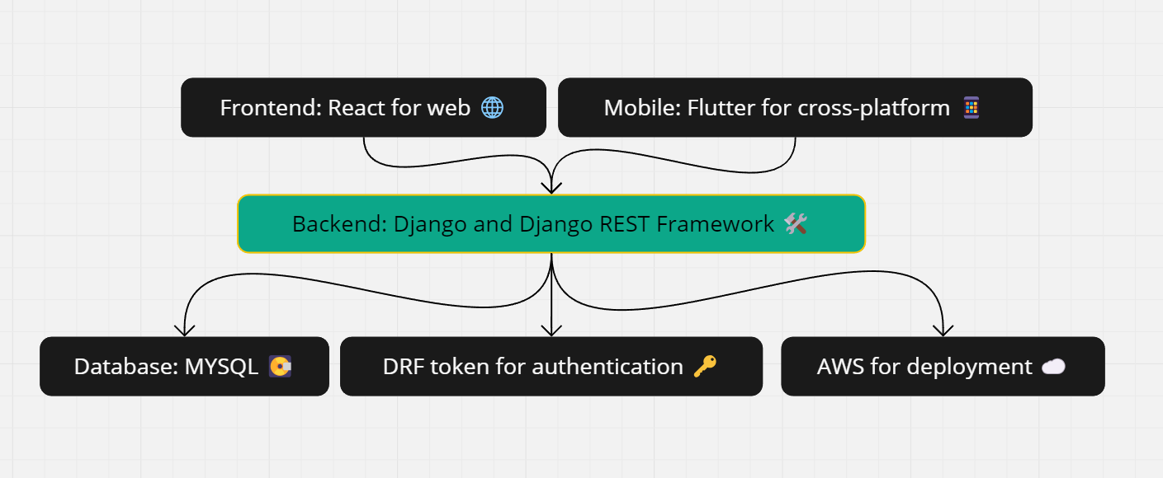
Technical Overview
Architecture:
Backend: Django and Django REST Framework.
Frontend: React for the web application.
Mobile: Flutter for cross-platform mobile app.
Database: MYSQL.
Technologies Used:
DRF token for authentication.
AWS for deployment.

Slide 9
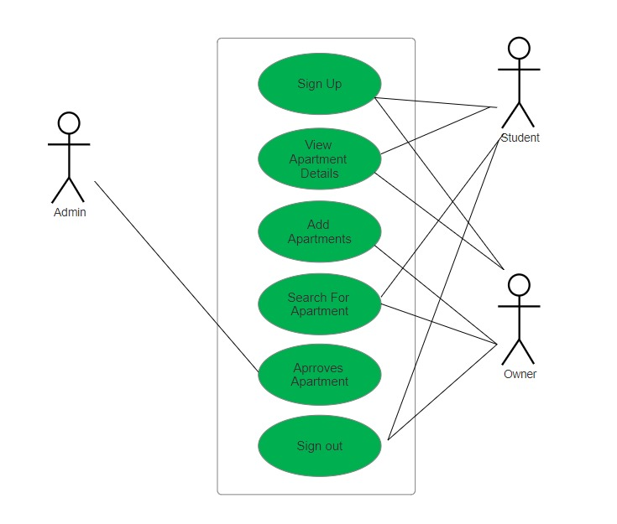
Use Case Diagram

Slide 10
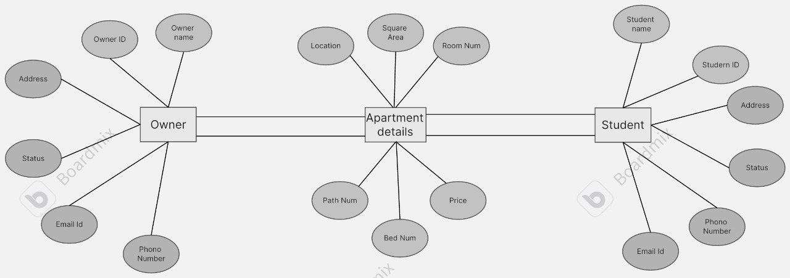
ERd Diagram

Slide 11
User Experience & UI Design
Design Process:
Research and analysis of user needs.
Creation of user personas.
Wireframing and prototyping.
Key Features:
Simplicity and usability.
Consistency in design elements.
Responsive design for different devices.

Slide 12

TOOLS

Slide 13
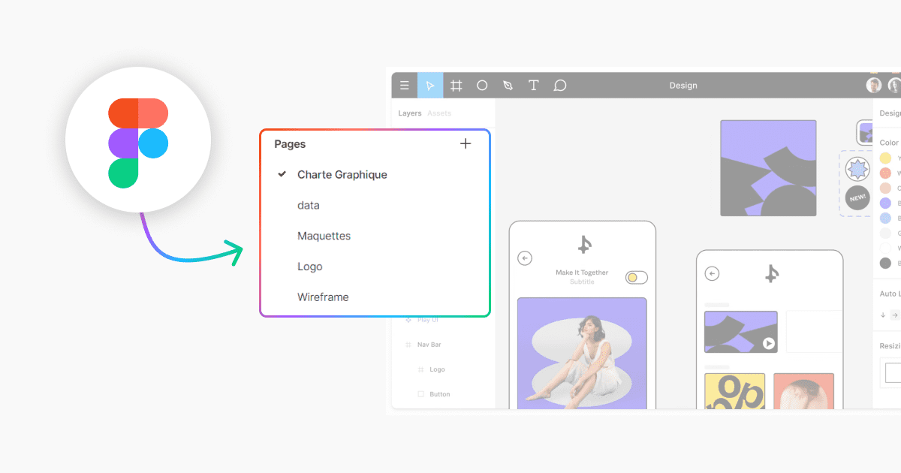

UI & UX

Slide 14






- HTML - CSS - JAVASCRIPT
- BOOTSTRAP
REACT
FORMIK
YUP
Axios
Interceptors
Cross site forgery protection handling
Cancelation tokens
- SweetAlert
FRONT-END TOOLS

Slide 15
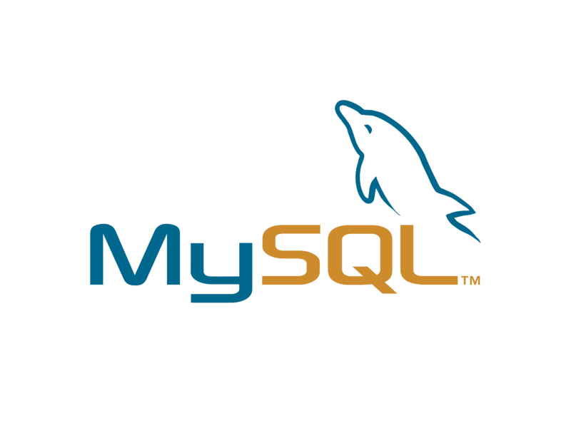

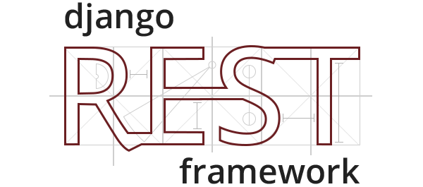



Django
MySQL
Django rest framework
Postman
BACK-END TOOLS
Drf spectacular
Visual studio code

Slide 16




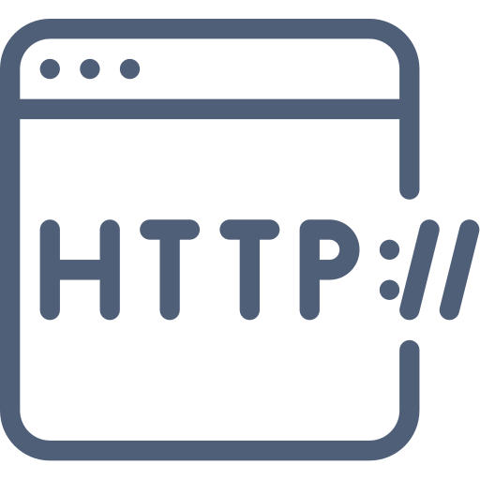
Dart
Dart
Flutter
Visual studio code
Android emulator
Version Control System
Dio
Http
Mobile App Development

Slide 17
Backend Development
Technologies and Frameworks:
Django: Web framework for building the backend.
Django REST Framework: For creating RESTful APIs.
MySQL: Database for storing data.
Key Features:
User authentication and authorization.
CRUD operations for apartment listings.
Search and filter functionalities booking

Slide 18
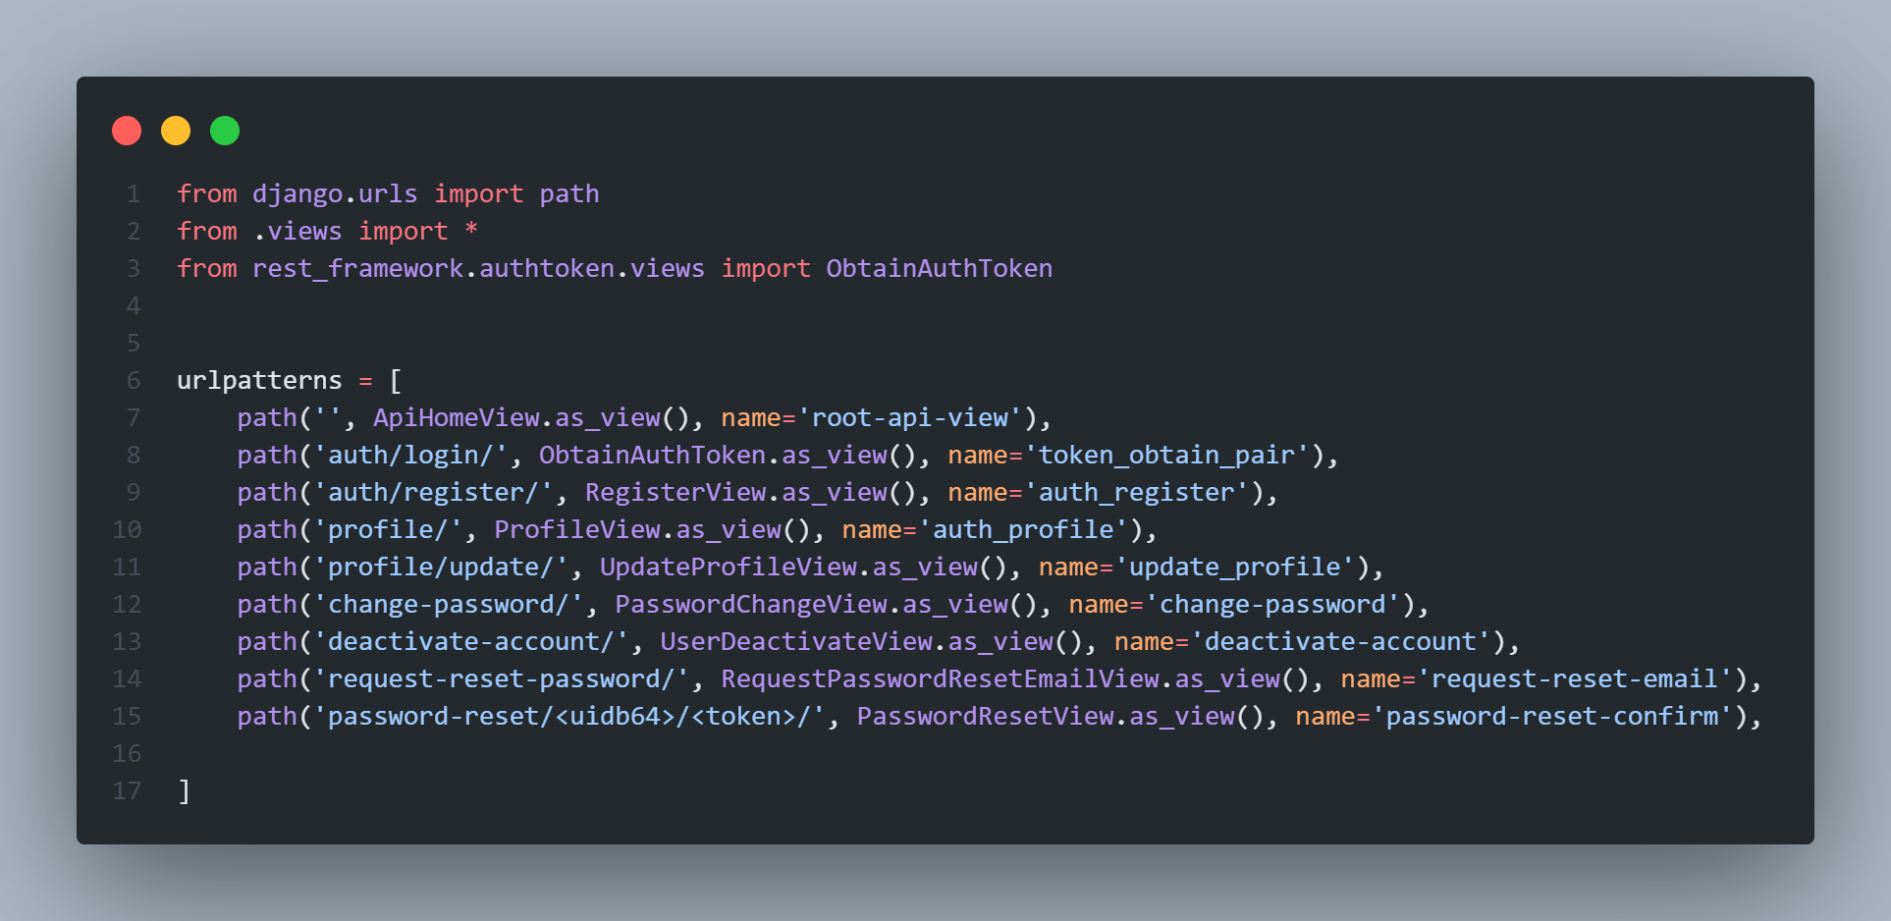
Purpose: Manage user authentication, registration, profile updates, and password management.
Endpoints:
Login: Authenticates users and returns a token.
Register: Handles new user registrations.
Profile: Retrieves and updates user profile information.
Change Password: Allows users to change their password.
Deactivate Account: Users can deactivate their accounts.
Password Reset: Manages the password reset process via email.
Tools and Technologies:
Django Rest Framework: Used to build and handle the API.
Token Authentication: Secures user sessions.

Slide 19
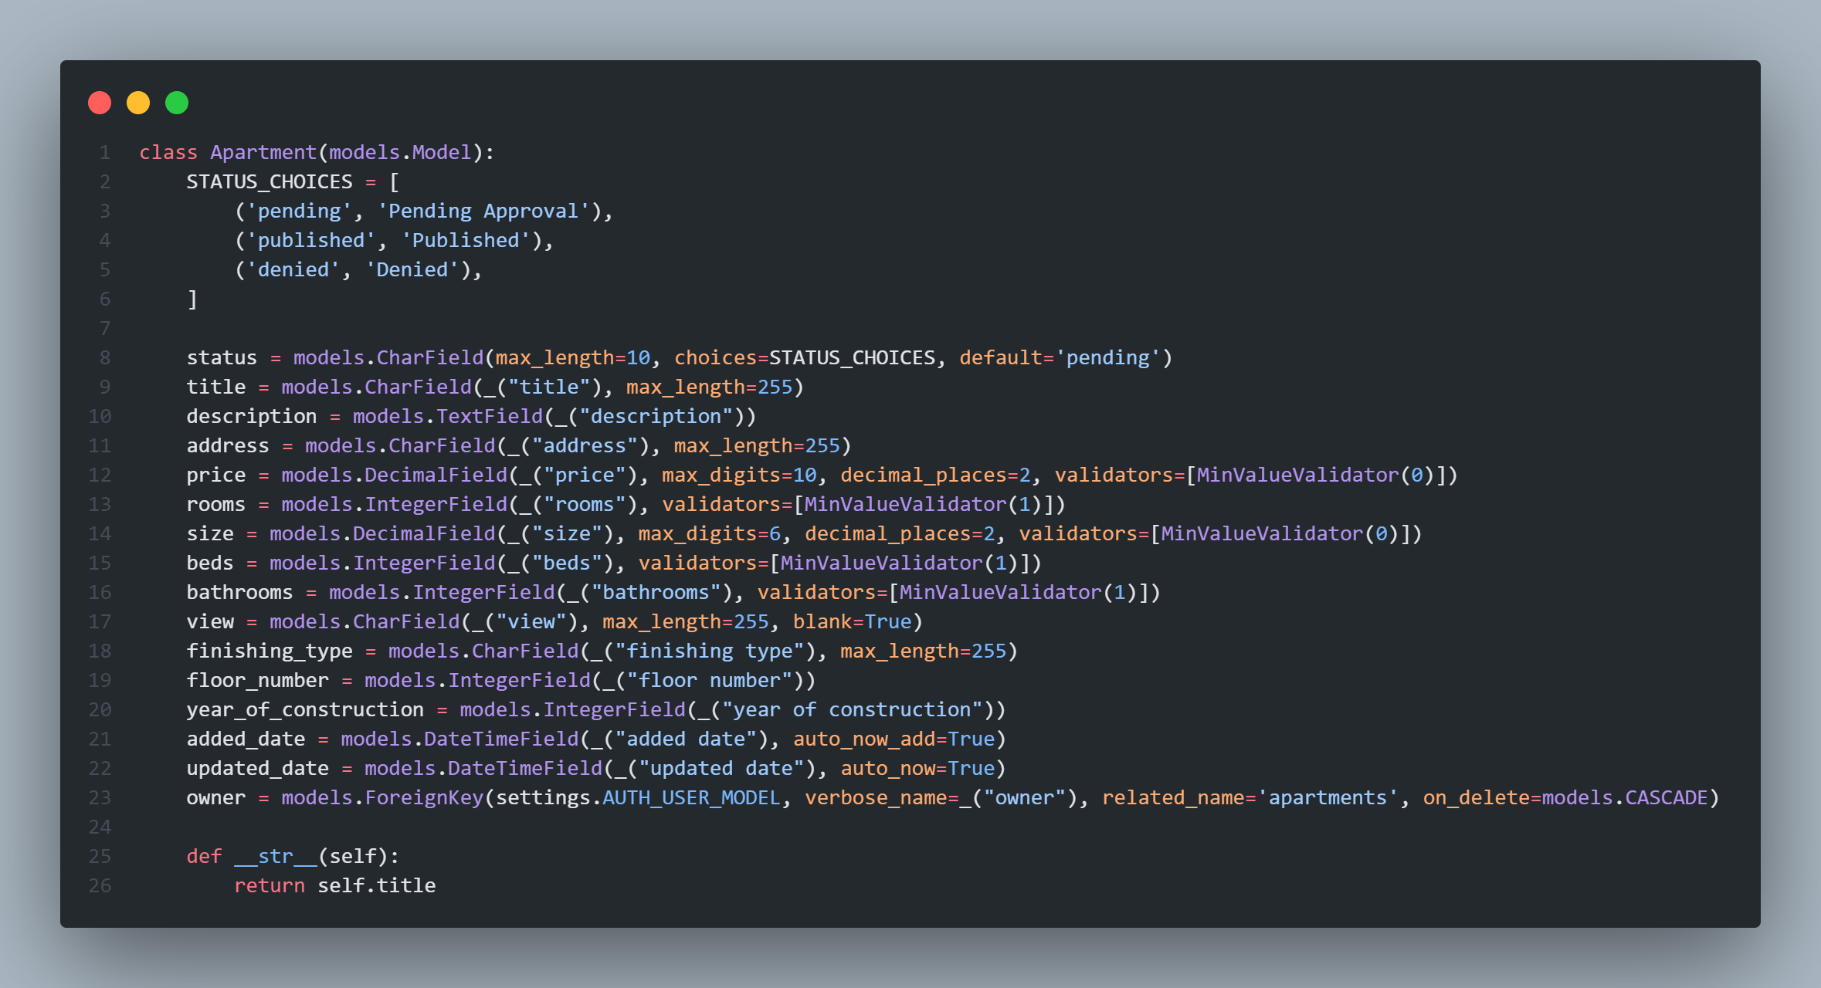
Overview:
This slide explains the structure of the Apartment model in the Django backend.
Key Points:
Fields:
status: Tracks approval status (pending, published, denied).
title, description, address, price: Basic details.
rooms, size, beds, bathrooms, view, finishing_type: Apartment features.
floor_number, year_of_construction: Additional details.
added_date, updated_date: Timestamps for creation and modification.
owner: References the apartment owner.
Validation:
Ensures data integrity with MinValueValidator for numeric fields.

Slide 20
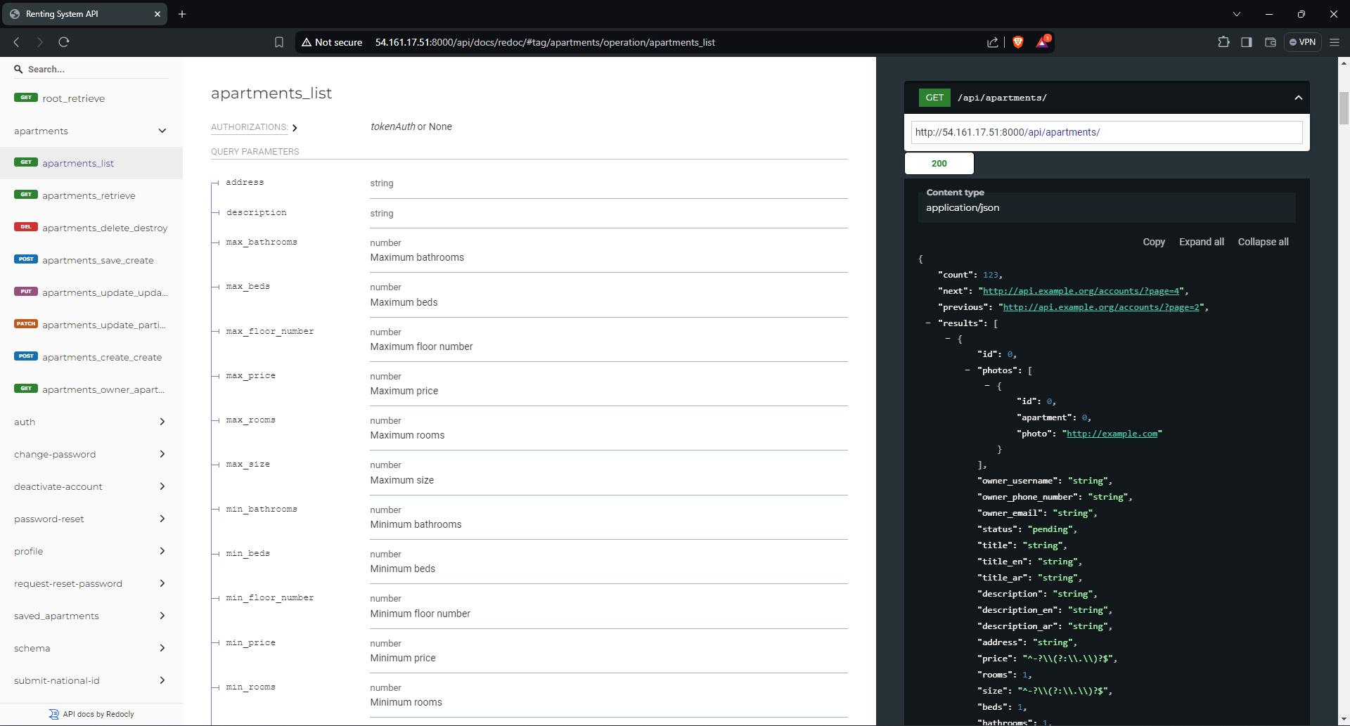
API Documentation:
API documentation generated using DRF Spectacular.
Endpoints: Lists all available endpoints for apartments.
Details: Shows query parameters and example responses for each endpoint. Key Points:
Clear API documentation.
Facilitates testing and integration.

Slide 21
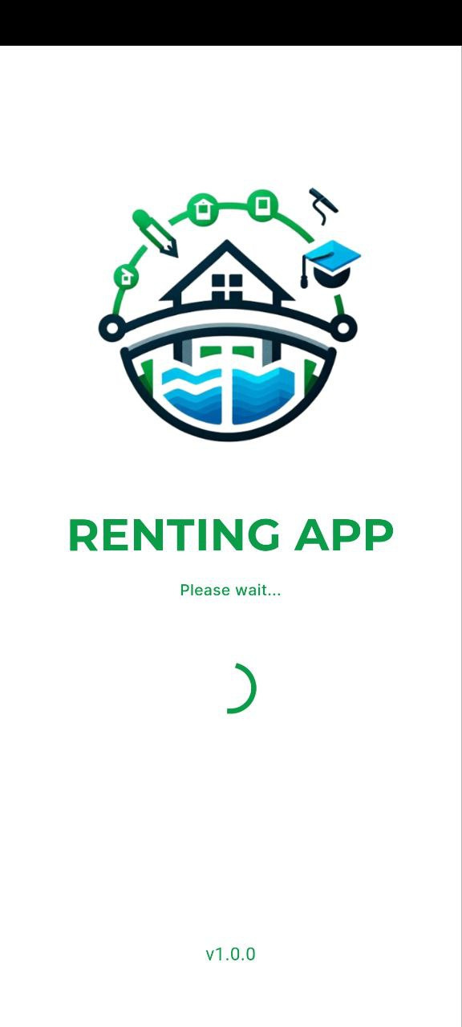
Renting
System
App
Explore Now

Slide 22
Mobile Development
Technologies and Frameworks:
Flutter: Framework for building cross-platform mobile applications.
Key Features:
User-friendly mobile interface.
Cross-platform compatibility (iOS and Android).Integration with backend APIs.

Slide 23
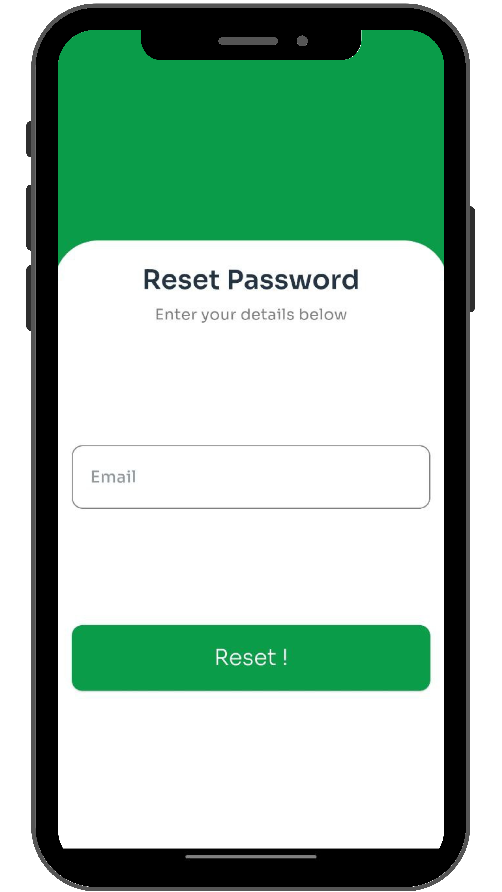
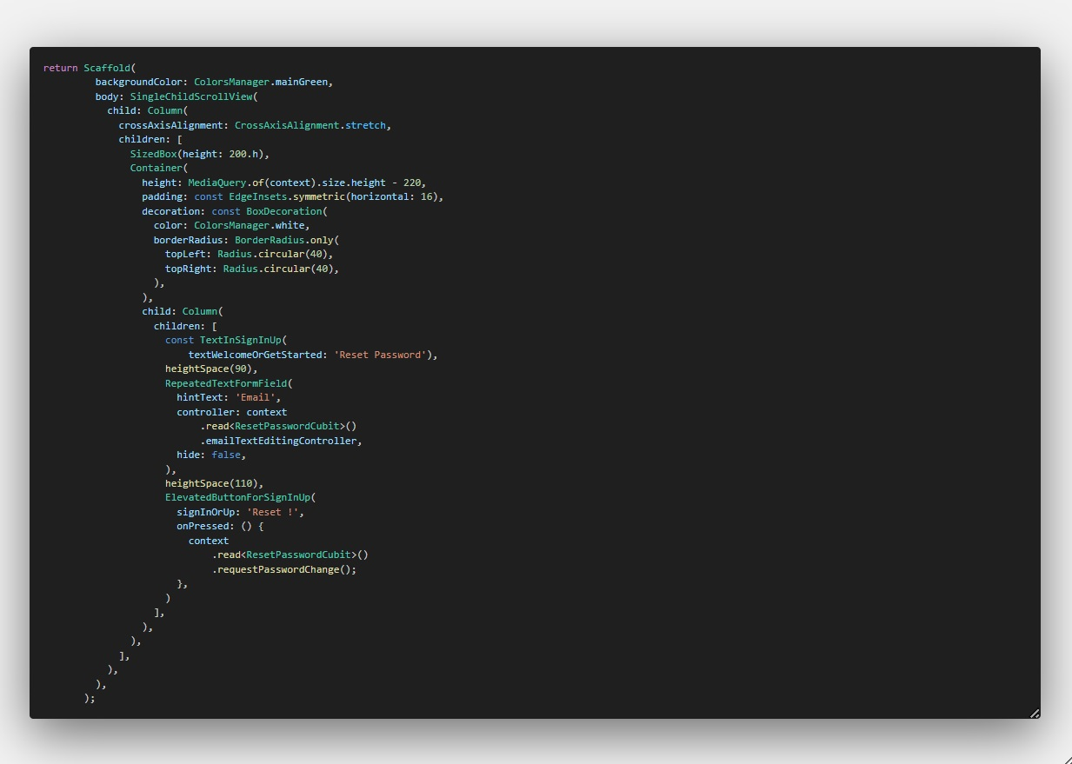

Slide 24
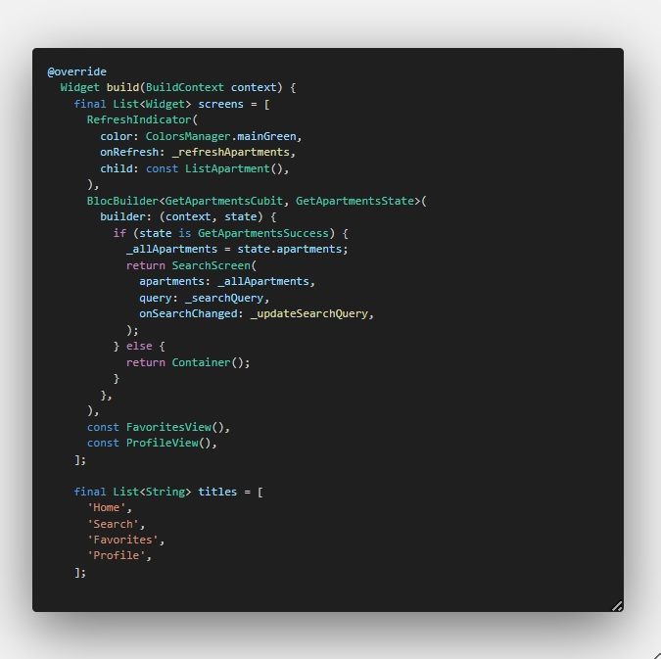

Slide 25
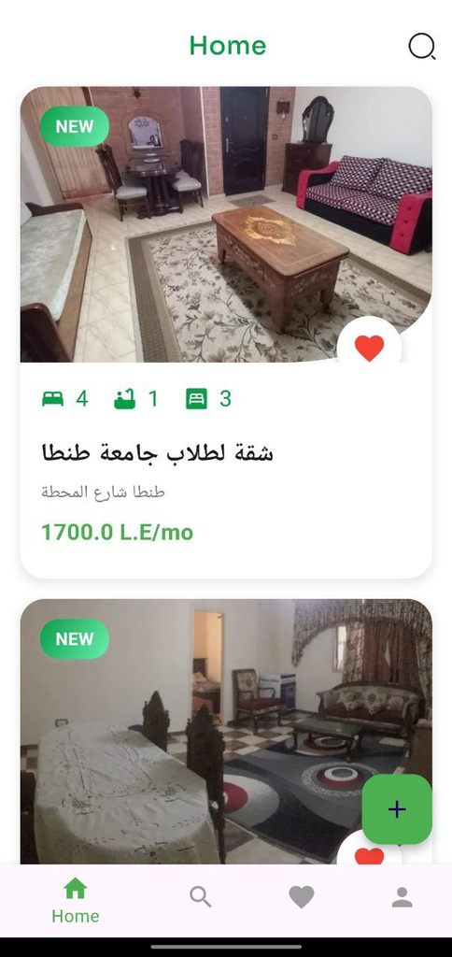
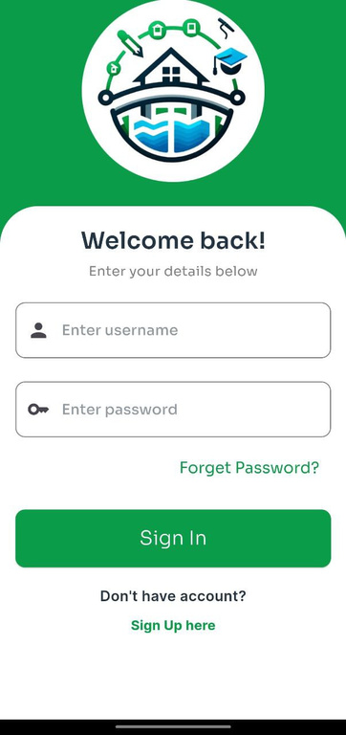
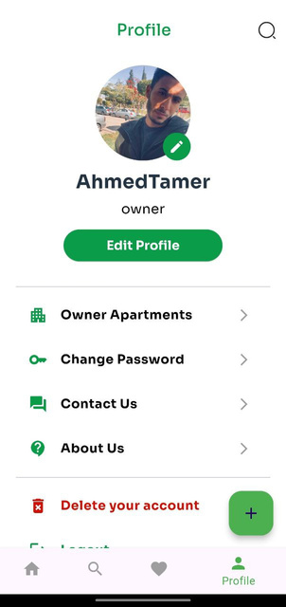
Welcome To Our Application
About Our Application
The primary goal of our project was to create a mobile application that connects apartment owners with potential renters, simplifying the rental process through digital innovation. The traditional rental market is often characterized by inefficiencies such as difficulty in finding suitable apartments, lack of reliable information, and cumbersome communication between owners and renters.

Slide 26
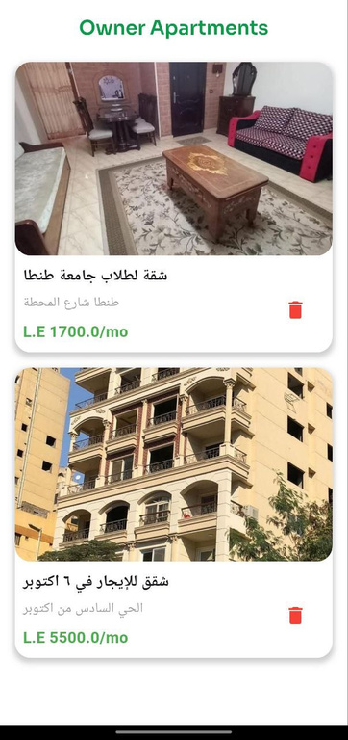
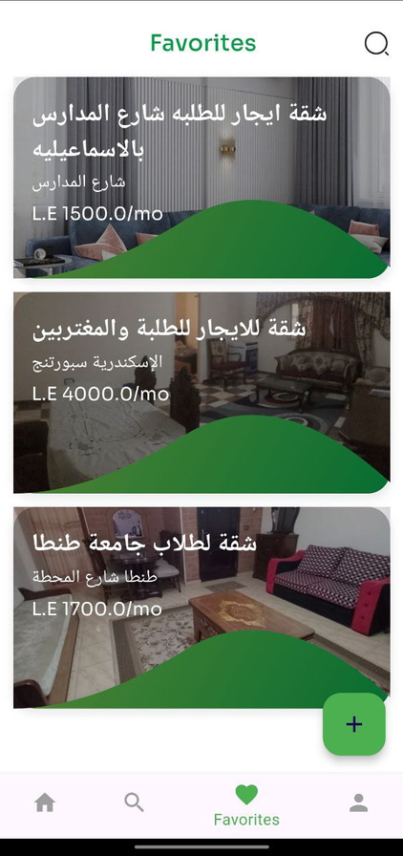
Application Advantages
01
User-Friendly Interface: The app provides a seamless and intuitive interface that allows both apartment owners and potential renters to navigate easily. Owners can effortlessly list their properties with detailed descriptions and photos.
02
Efficient Communication: The app includes built-in messaging and notification systems to facilitate real-time communication between owners and renters.
03
Enhanced Security: The app offers secure user authentication and data encryption to protect personal information and transaction details. By providing a safe and trustworthy environment, the app builds confidence among users.
04
Streamlined Rental Process: The app simplifies the entire rental process from start to finish. Renters can search for apartments, schedule viewings, submit rental applications, and even sign rental agreements digitally.

Slide 27
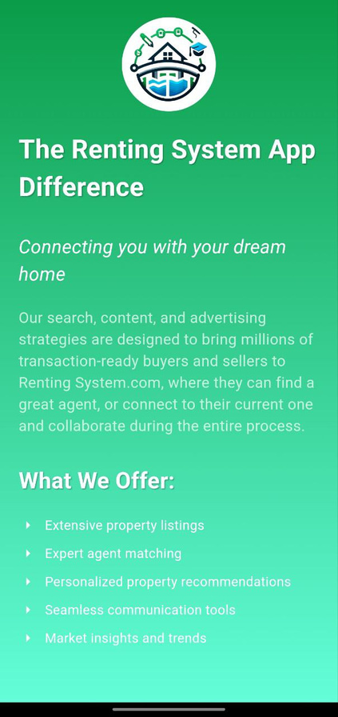
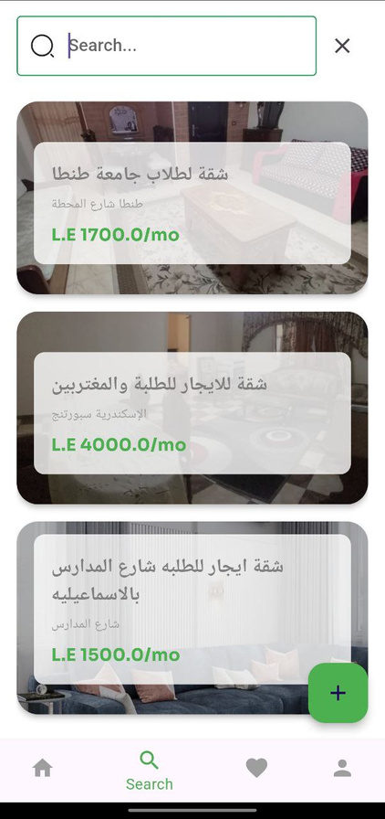
Application Features
01
User-Generated Content (UGC): The app allows users to contribute their own content, including reviews, ratings, and photos of apartments they have rented. This feature fosters a sense of community and encourages user engagement.
02
Advanced Search and Filter Options: The app provides robust search and filtering capabilities to help renters find apartments that meet their specific criteria. Users can apply filters based on location, price range, apartment size, amenities, and more.
03
Favorite Items: The app allows users to easily mark and save their preferred items as favorites. By clicking on a heart icon next to an item, users can add it to their personalized favorites list. This feature enhances the user experience by providing quick access to frequently used or liked items. Users can view and manage their favorites through a dedicated section, ensuring a more tailored and efficient interaction with the app.

Slide 28
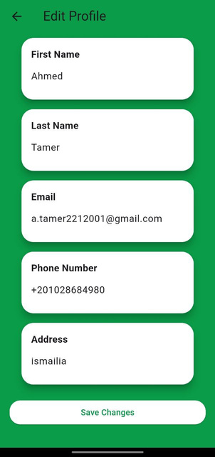
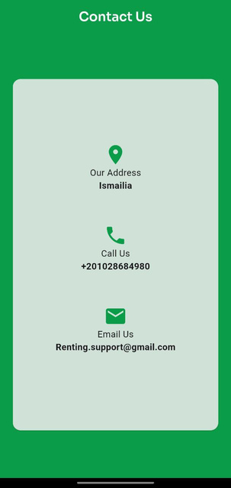
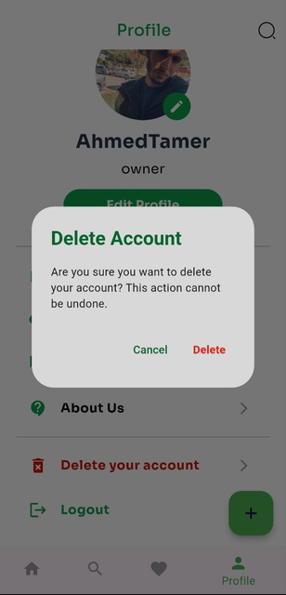
Profile Section
The Renting System mobile application serves as the primary interface for users. It is installed on users' smartphones and provides access to the app's features and functionalities. The mobile app interacts with various components of the system to View Apartment details or Add Apartment, and fetch information.

Slide 29
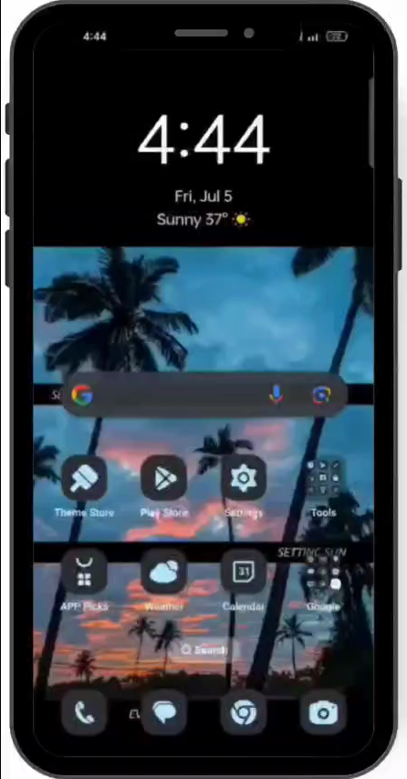
Project Demo
( Mobile)

Slide 30
Frontend Development
Technologies and Frameworks:
React: JavaScript library for building user interfaces.
Context: State management for React applications.
Key Features:
Responsive UI design.
Dynamic search and filter functionalities.
Integration with backend APIs.
User account management.

Slide 31

Renting
System
website
Explore Now

Slide 32

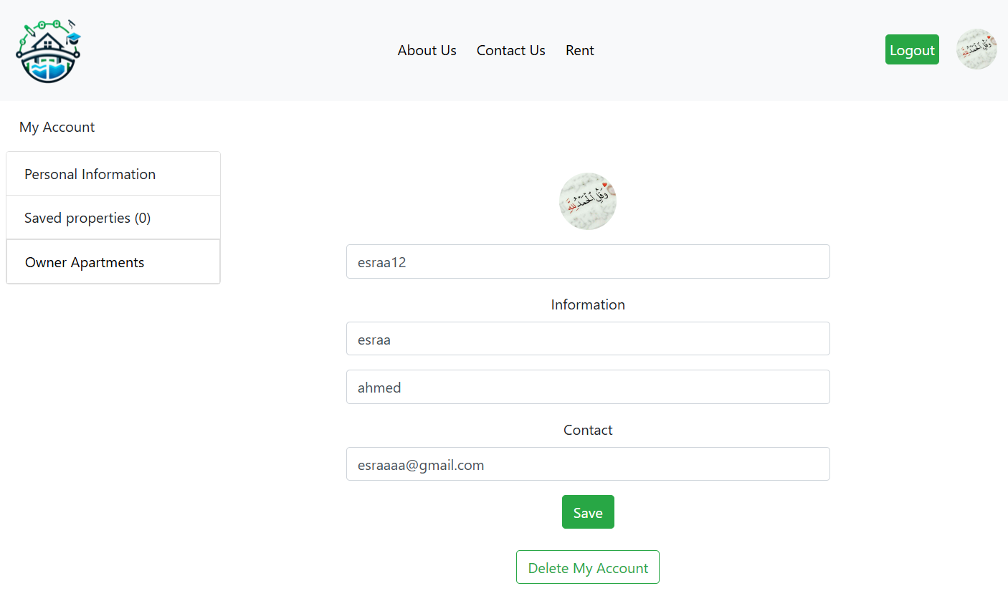
Welcome To Our website
About Our website
The primary goal of our project was to create a website that connects apartment owners with potential renters, simplifying the rental process through digital innovation. The traditional rental market is often characterized by inefficiencies such as difficulty in finding suitable apartments, lack of reliable information, and cumbersome communication between owners and renters.

Slide 33
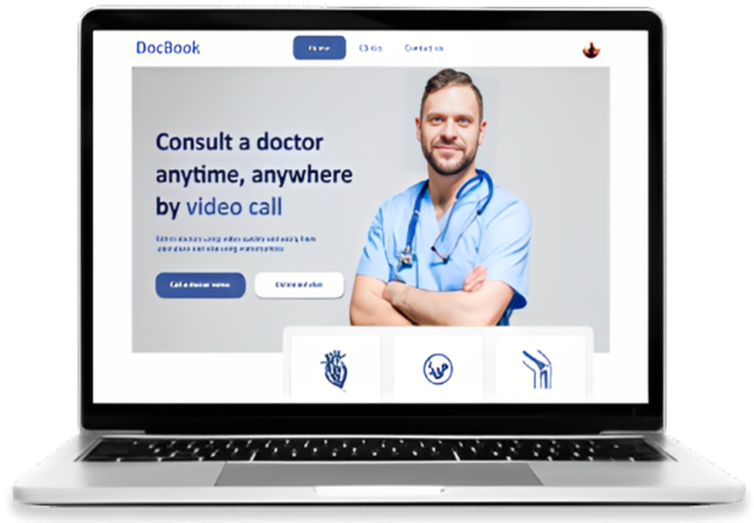
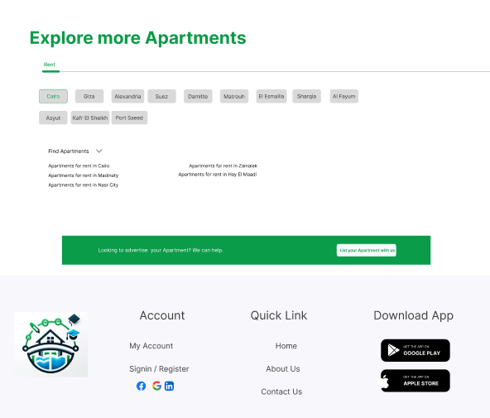
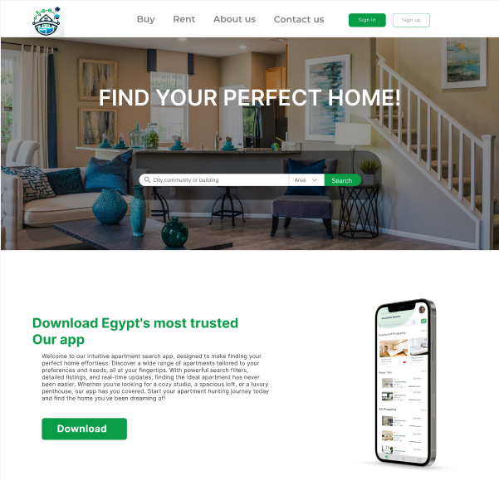
Home Screen

Slide 34
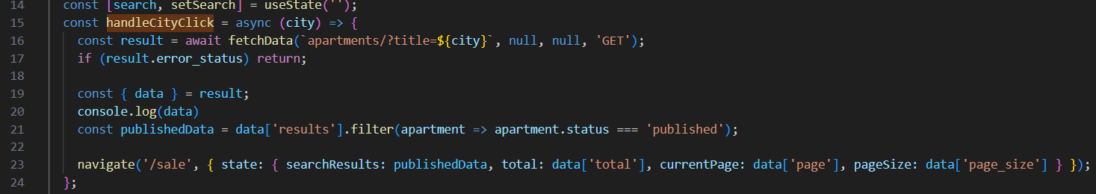
Code the important part in home page

Slide 35
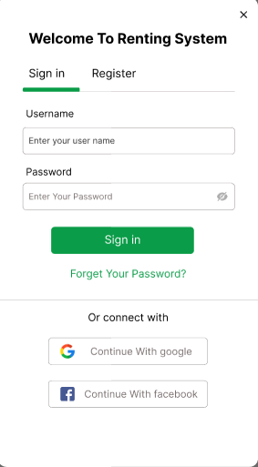
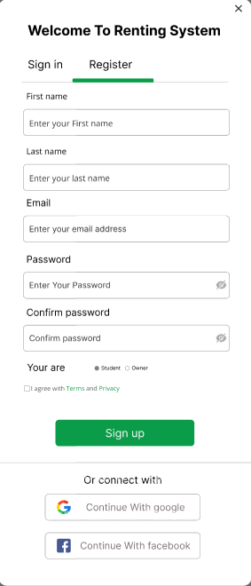
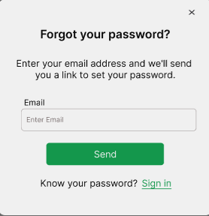
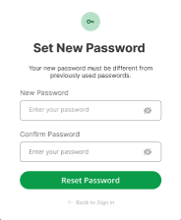
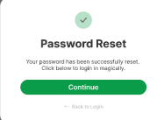
Sign In Screen Register Screen
Forget password

Slide 36

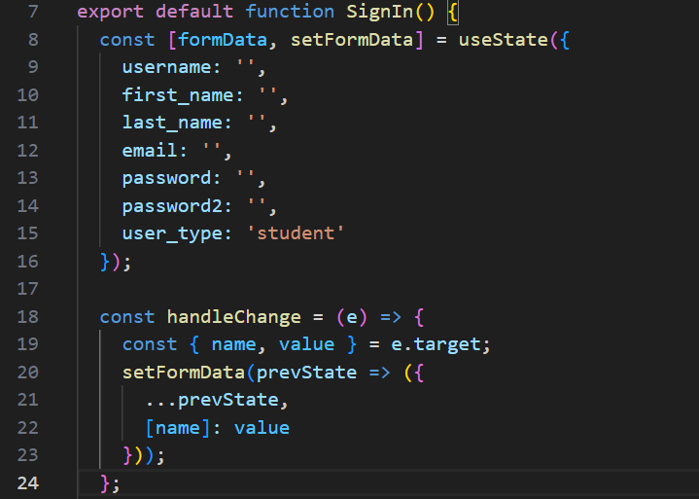
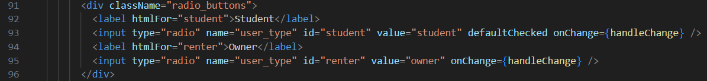
Code the important part in sign in page

Slide 37
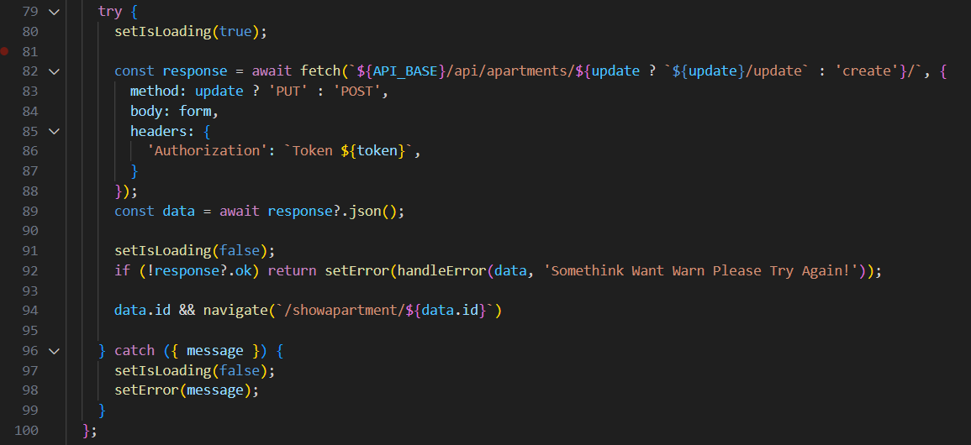
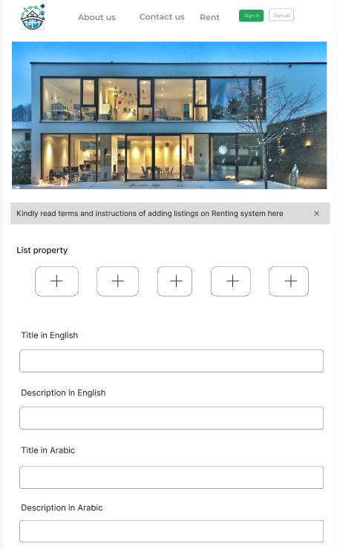
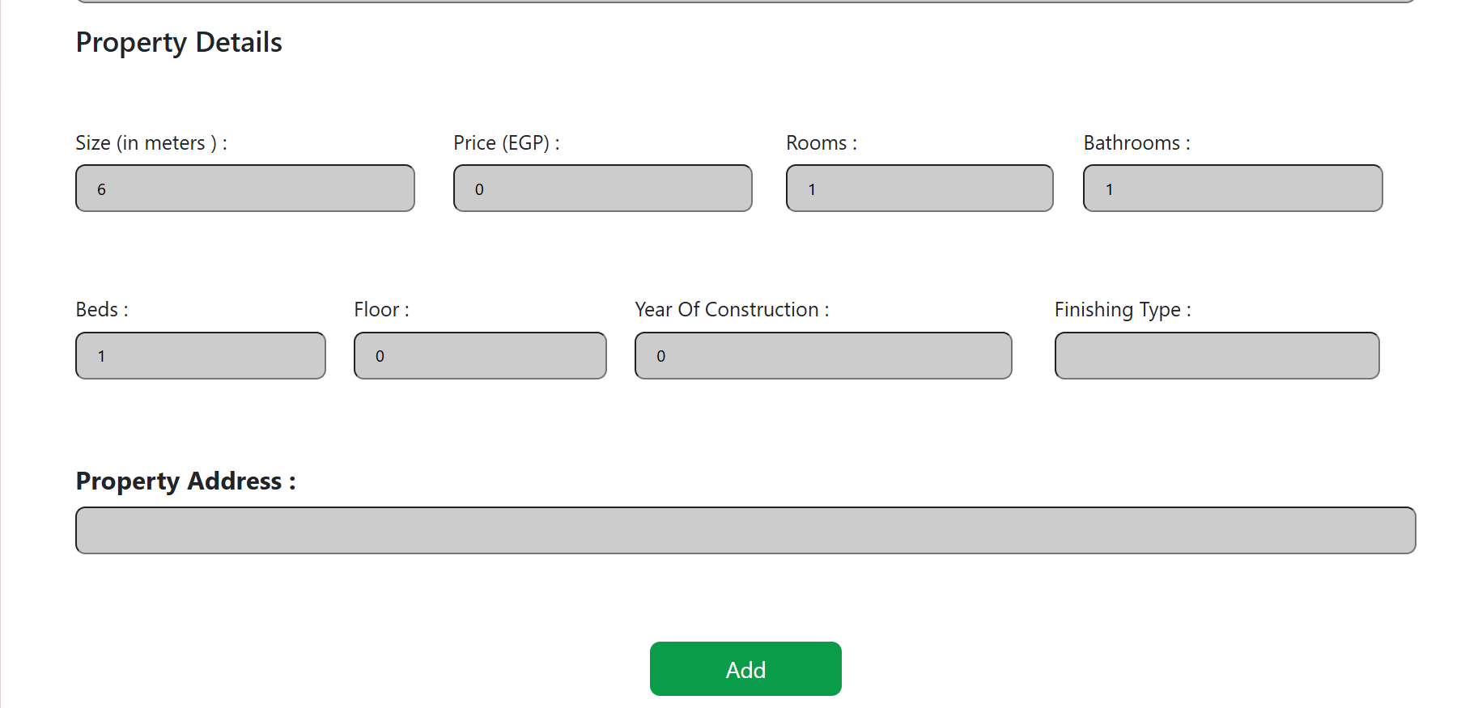
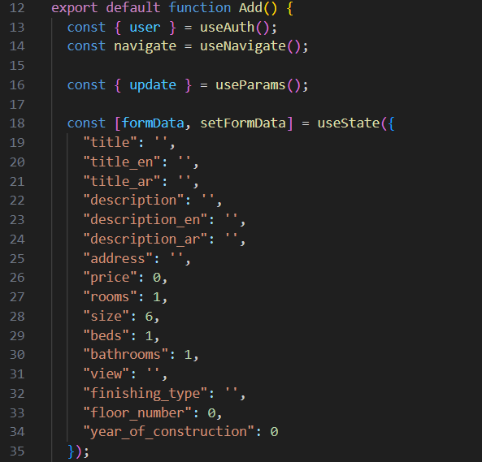
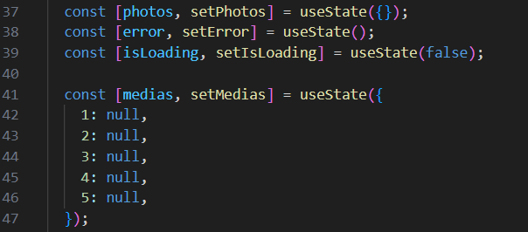
Add Apartment

Slide 38
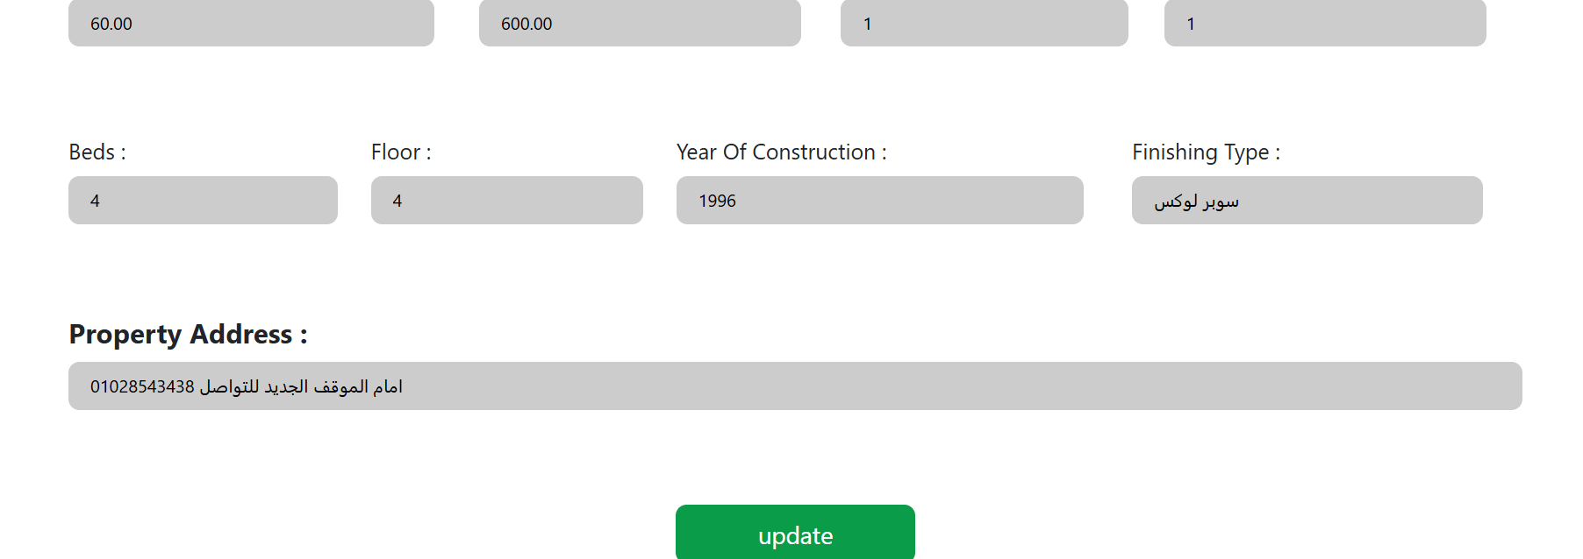
Edit Owner Apartment

Slide 39
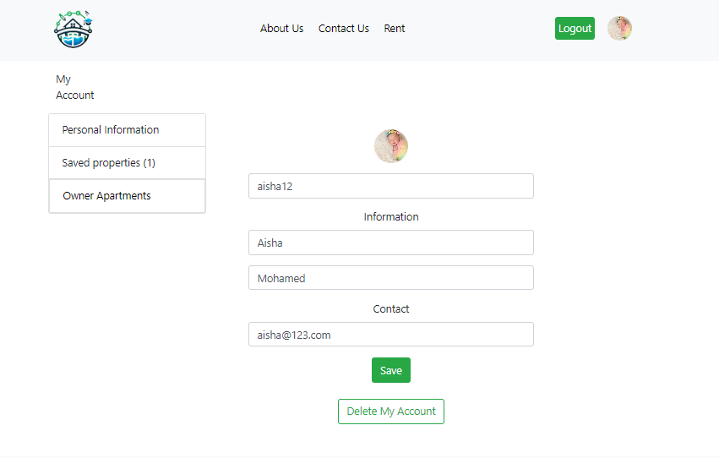
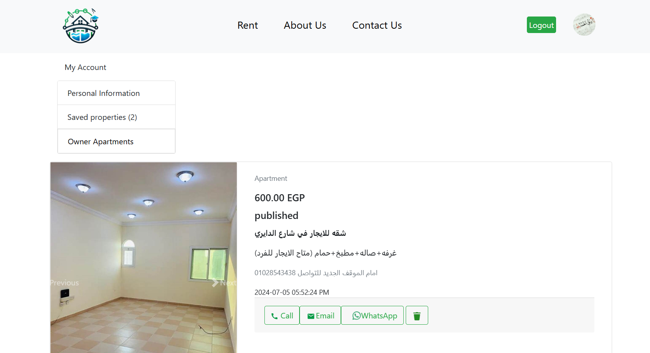
Owner Profile
Personal information
Owner apartment

Slide 40
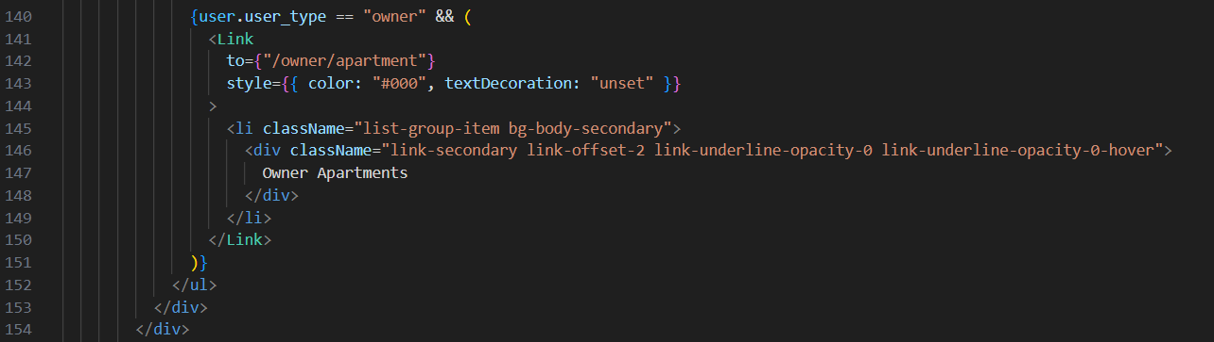
Owner Profile

Slide 41


Student Profile
Personal information
Saved Properties

Slide 42

Apartments for rent

Slide 43



Code the important part in search filter & saved favorite
&

Slide 44

Published Apartment

Slide 45

Apartment details

Slide 46



About us
Contact us

Slide 47

Project Demo ( Website)

Slide 48
Challenges & Solutions
Key Challenges:
Integration of multiple technologies.
Ensuring cross-platform compatibility.
Handling high traffic and ensuring performance.
Solutions:
Extensive testing for mobile and web platforms.
Optimization of database queries and use of caching.

Slide 49
Future Work
Planned Features:
Buy Option: Allow users to buy apartments and houses.
Monthly Subscriptions: Offer premium features for subscribers.
Advertisements: Integrate ads to generate additional revenue.
Potential Improvements:
User Interface: Enhance based on feedback.
Performance: Optimize for better speed and efficiency.
Third-Party Integrations: Integrate with payment gateways and property management tools.

Slide 50
Testing & Quality Assurance
Testing Strategies:
Unit testing for backend and frontend code.
Integration testing for API endpoints.
User acceptance testing.
Tools Used:
Postman for endpoints tests.
EmailJS is a service that allows you to send emails directly from JavaScript without needing to set up a backend server.
Microsoft edge for automated UI testing.

Slide 51

Testing & Quality Assurance
API call to create a new apartment listing. The request includes details like title, description, address, and price. The response confirms the creation with a status of "pending" for approval.
Request: JSON body with apartment details.
Response: JSON response with created apartment info and status.
Key Points:
Simplifies adding new listings.
Captures all necessary details.
Manages approval status.

Slide 52

Deployment Process:
AWS Deployment: Deployed on AWS EC2 using Docker for containerization and ECS for orchestration.
Monitoring & Logging: AWS CloudWatch used for monitoring application performance and logging.
Tools and Platforms:
GitHub Actions: Used for Continuous Integration and Continuous Deployment (CI/CD).
AWS: Leveraged for hosting and infrastructure.
EC2: Used for hosting the Django application.
Deployment

Slide 53
Key Takeaways from the Project:
Importance of clear communication and teamwork.
Value of continuous integration and deployment (CI/CD) practices.
Lessons Learned During the Development Process:
Technical Skills:
Enhanced knowledge of Django, React, and Flutter.
Gained experience in implementing security best practices.
Problem-Solving:
Developing effective solutions for unexpected challenges.
Learning from mistakes and adapting quickly to changes.
Lessons Learned

Slide 54

Thank Everyone Who Contributed to the Project:
Supervisors:
Dr. Mohamed Elsharkawey For providing guidance and support throughout the project.
Dr. Haidy Saeed For valuable feedback and insights.
Acknowledgements

